Slide 1
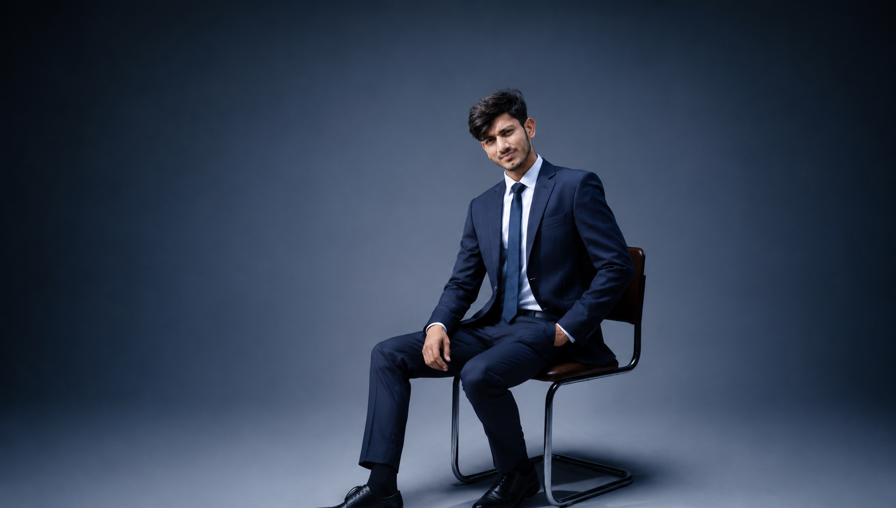
PORTFOLIO
Hi, I’m Ahmad Performance Marketing Specialist
—
+92 301-7740420
@Ahmedjalal
mahmadmj78@gmail.com

Slide 2
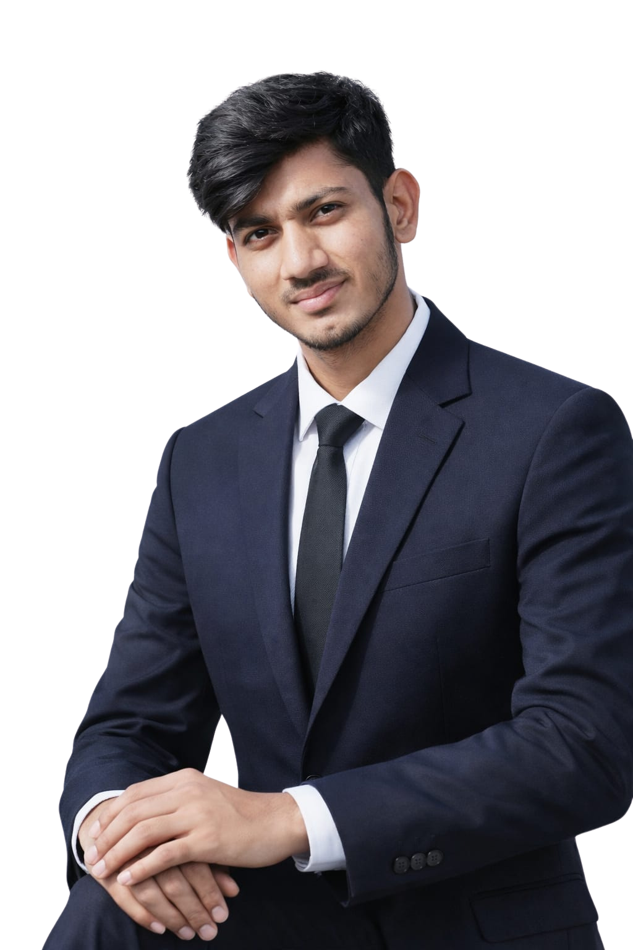
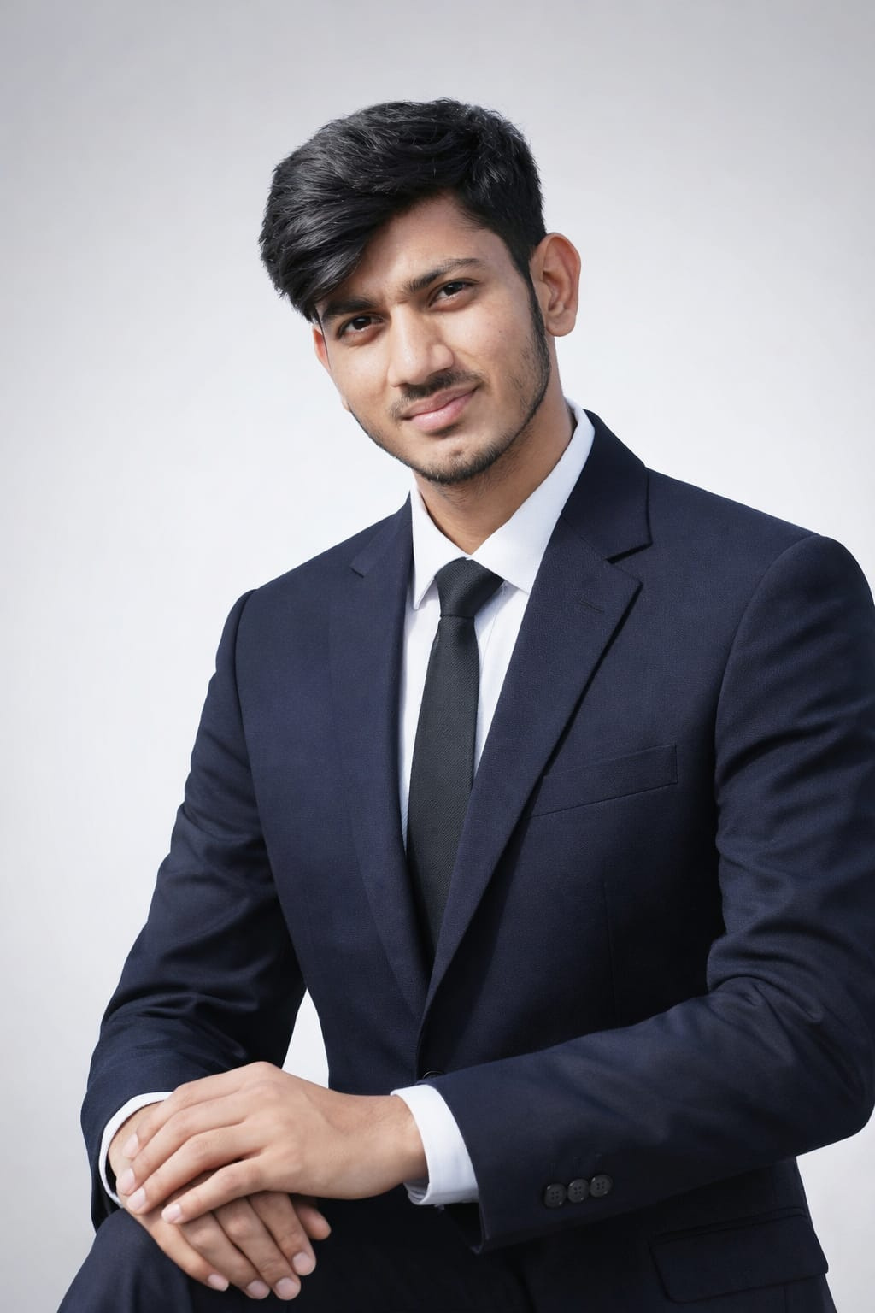
ABOUT ME
Professional Summary
Digital Marketing & Performance Specialist with 5+ years of experience driving scalable growth &
generating over 8X ROAS on PPC campaigns, boosting 28% ROI for eCommerce and service-based
clients, and ranking 280+ keywords on Google’s first page. Specialized in performance marketing,
growth strategy, and conversion.
Expert in managing multi-channel campaigns across Google Ads, Meta Ads, Bing Ads, and SEO
strategies for international clients in USA, UAE, UK, and Pakistan.
Experience
Senior PPC Specialist — Source Code ( Present )
I Managed end-to-en d PPC strategies & campaigns for 4–5 businesses across niches such as eBook selling, UK academies, and health clinics.
Muhammad Ahmad
Performance Marketing Specialist
Senior PPC Specialist — WigaTeach ( 2025 )
Managed end-to-end PPC strategies for 3–4 diverse businesses, including animations and leather jackets, focusing on performance optimization, budget allocation, and conversion tracking.

Slide 3

KEY SKILLS
SERVICES PROVIDED
Google Ads Campaign Strategy & Planning
Lead Generation Campaigns
eCommerce Google Ads Management
Search, Display, Shopping & Performance Max Campaigns
Performance Max Campaigns
Conversion Tracking (GA4, Google Tag Manager)
Remarketing Campaigns
Conversion Tracking Setup
EXPERTISE & OFFERINGS

Slide 4
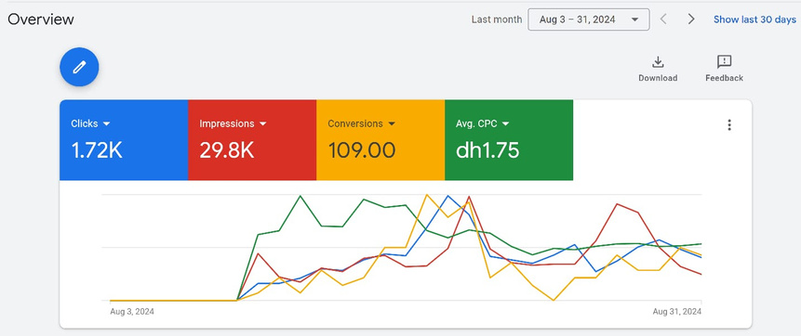
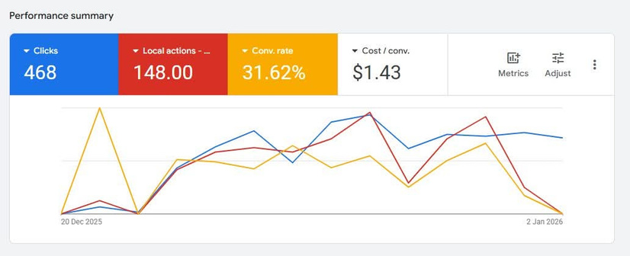
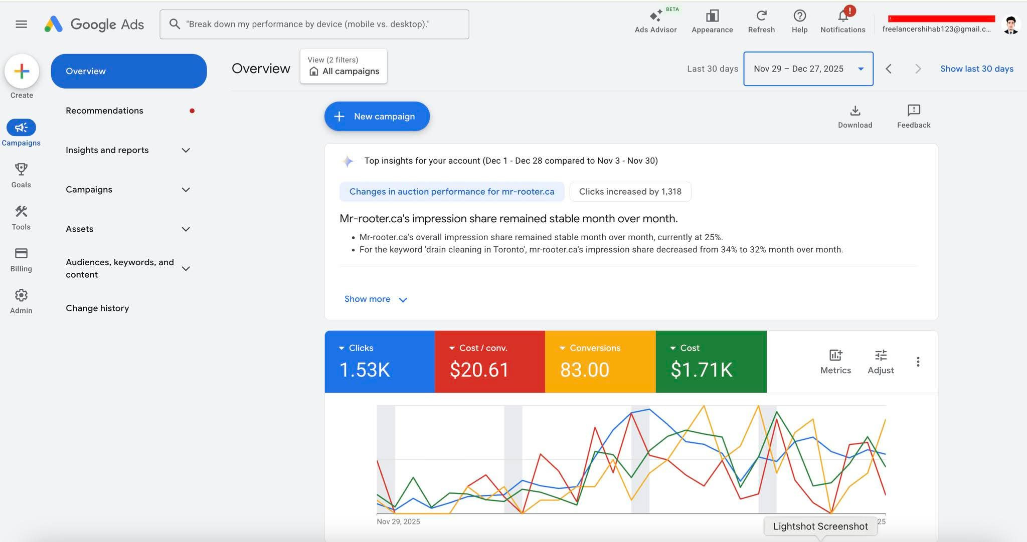
OVERVIEW
Selected works
Fit Out Design
Successfully managed a Google Ads Lead Generation Campaign for MD Design & Fit Out, a Dubai-based interior design company, delivering strong performance within the campaign period.
Campaign Performance:
Clicks: 1.72K, Impressions: 29.8K, Conversions (Leads): 109, Average CPC: AED 1.75
RSP
Successfully managed a Google Ads Responsive Search Ads (RSA) Campaign, focused on generating high-quality leads while maximizing conversion efficiency through AI-powered ad optimization.
Campaign Performance:
Clicks: 468, Conversions (Local Actions): 148, Conversion Rate: 31.62%
Cost per Conversion: $1.43
Mystorypublisher
Successfully managed a Google Ads eBook Lead Generation Campaign, focused on generating high-quality leads through downloadable eBook offers while maintaining an excellent cost per conversion.
Campaign Performance:
Clicks: 468, Local Actions / Conversions: 148, Conversion Rate: 31.62%, Cost per Conversion: $1.43

Slide 5
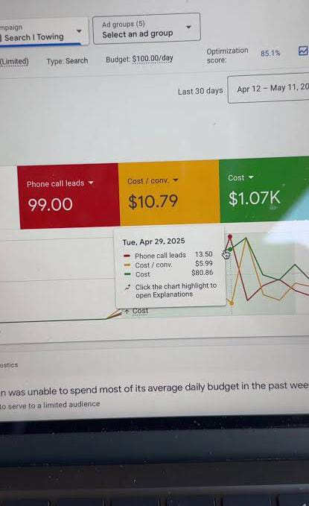

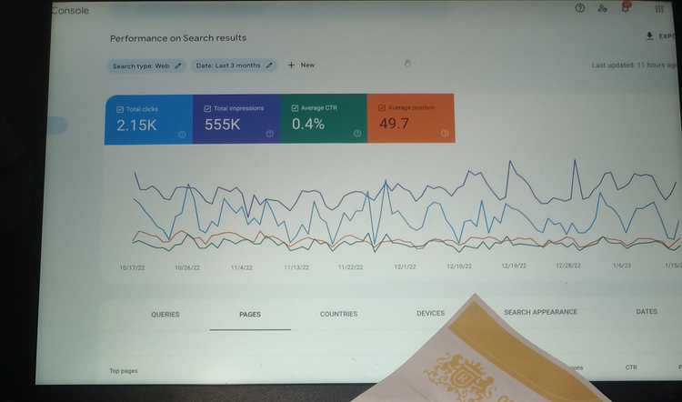
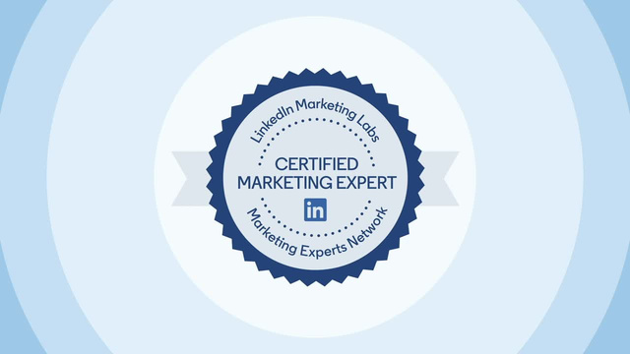
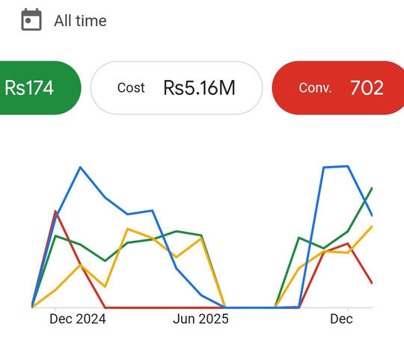
PROJECT
Performance Marketing Case Study
Driving measurable business growth with Google Ads, Meta Ads, and data-driven optimization.
PPC Campaign Excellence
Creating high-performing campaigns that generate qualified leads, increase conversions, and maximize return on ad spend.

Slide 6


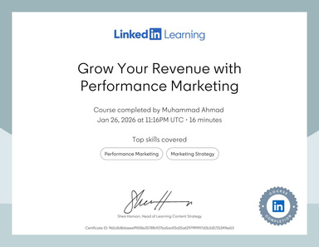
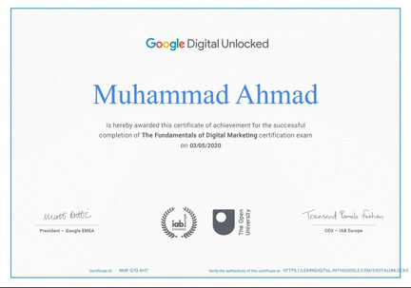



PROJECT WORKFLOW
Brief
Certificate
As a Performance Marketing Specialist with over 6 years of experience, I have successfully planned, executed, and optimized Google Ads and Meta Ads campaigns across multiple industries, including eCommerce, real estate, interior design, healthcare, education, and local businesses.
Deliver
Feedback
Successfully managed high-performing Google Ads campaigns, generating quality leads through data-driven optimization.

Slide 7

LET’S BUILD SOMETHING GREAT TOGETHER
I'm currently available for freelance and full-time opportunities

Slide 8


DROP A MESSAGE
Connect with me —
and explore how we can create something impactful together
+92 301 7740420
mahmadmj78@gmail.com
@Ahmad

